Slide 1
Temporary Parking System
Tutorial Scope: All ASSB staff
20-Apr-2023 Rev. 0

Slide 2
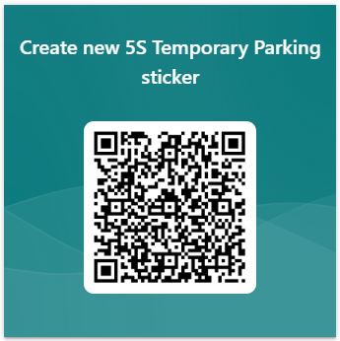
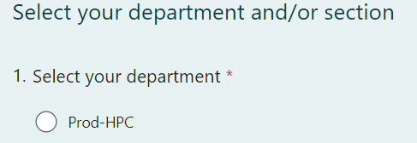
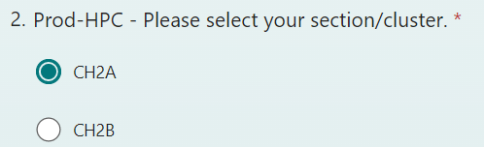
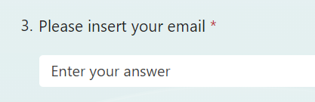
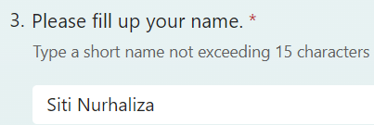
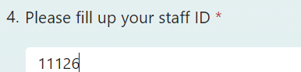
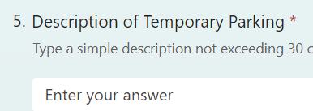
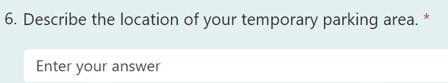
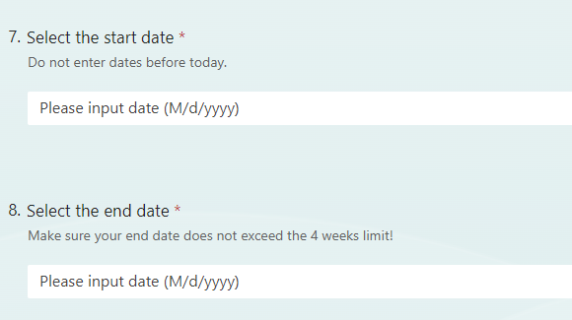
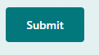
5S Temporary Parking System
Process Flow
User | Ticket email | Notification email | FORM
Start
Use your phone to scan this QR code to navigate to the registration form.
Alternatively, click this link: https://forms.office.com/r/6NKixTYApC
Ticket send to gate leader’s email
Scan QR code or open link temporary parking
Fill up the form
1 ) Select department & section
Shop Floor
Submit form
Notification send to receiver ticket’s email and the SM one day before due date
Office only
Get the ticket from your email / registered email
Requestor from?
Print the ticket and attached at your temporary parking item
Office
2 ) Fill up your name and staff ID
Ticket send to requestor’s email
2nd notification send to receiver ticket’s email and the SM on the day of the due date
Remove the items before the due date
3 ) Describe the temporary parking item and the area to be parked
Due date email notification
End
4 ) Select the start date and the end date
End
* Make sure the end date does not exceed 4 weeks from the start date, otherwise the request will be rejected!

Slide 3
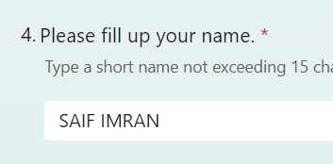
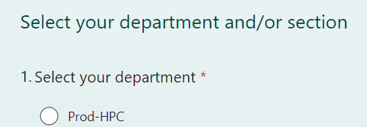
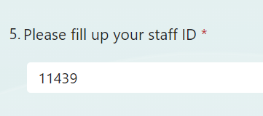
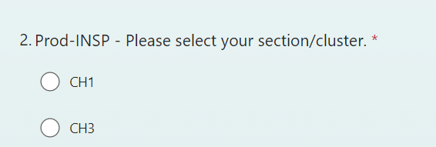
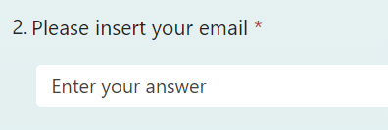
Temporary Parking System
Tutorial 1: How to register new Temporary Parking ticket (1/2)
1
Use your phone to scan this QR code to navigate to the registration form.
Alternatively, click this link: https://forms.office.com/r/6NKixTYApC
3
Fill up your name and your Staff ID
Once done, click Next.
2
Begin with your select the department and your section/cluster.
Fill in your ASSB email if prompt.
Once done, click Next.

Slide 4
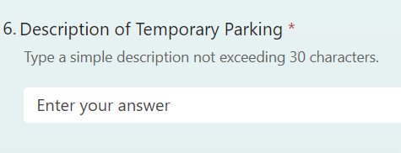
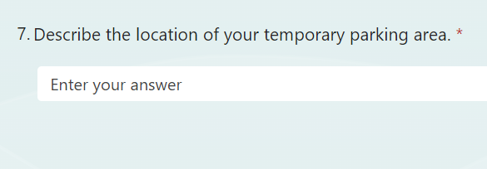
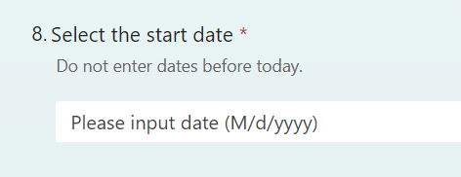
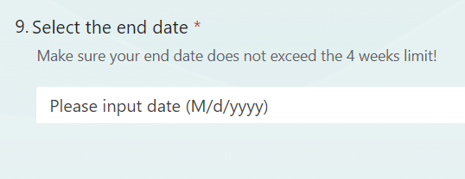
Temporary Parking System
Tutorial 1: How to register new Temporary Parking ticket (2/2)
4
Fill the description for the temporary parking and describe the location of the temporary parking area.
5
Then, select the start date of this temporary parking and followed by the end date.
Make sure the end date does not exceed 4 weeks from the start date, otherwise the request will reject.
Once done, click Submit.

